Slide 1

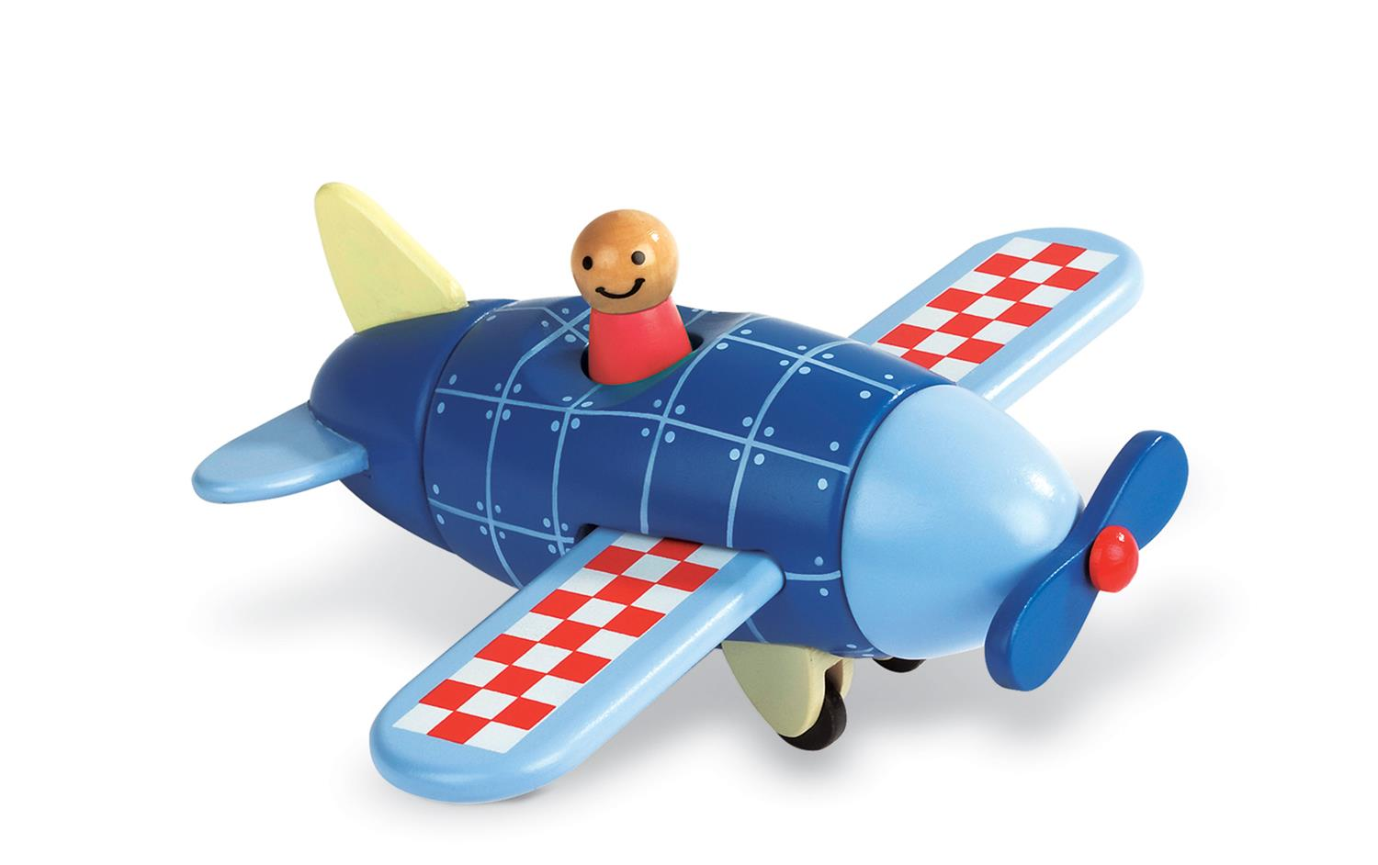
Airplane Magnet Kit
Toy Name
Airplane Magnet Kit
Manufacturer
Janod
Age
24 – 36 months
Parts
5 Magnetic Parts
Develop Skills
Fine Motor
Imagination
Cognitive
How it Works
Bongkar dan ajak anak Anda untuk memasangkan kembali pesawatnya dan terbangkanlah ke destinasi imajinasi mereka!
-
Take apart and ask your toddler tp put back together the airplane and fly it off to their imaginary destinations!
How To Clean
Simply clean using a cloth that has been sprayed with non-toxic anti bacterial solution
Warning
Do not wash/soak in water
Store in a dry place
Keep out of direct sunlight

